Slide 1




SPANNING – TREE PROTOCOL
Switching Basics and Intermediate Routing
Version 3.0
Cisco Regional Networking Academy

Slide 2
Objectives
Define redundancy and its importance in networking
Describe the spanning tree in a redundant-path switched network

Slide 3
Table of Content
1 | Redundant topologies
2 | Spanning tree protocol

Slide 4

REDUNDANT TOPOLOGIES

Slide 5
Redundant switched topologies
Server/Host X
Router Y
Segment 1
Switch A
Switch B
Segment 2
Notes:
See 7.1.1, 7.1.2, 7.1.3
Redundant topologies eliminate single points of failure. If a path or device fails, the redundant path or device can take over the tasks of the failed path or device.
A redundant switched topology may cause broadcast storms, multiple frame copies, and MAC address table instability problems.

Slide 6
Broadcast storms
Server/Host X
Router Y
Segment 1
Switch A
Switch B
Segment 2
Notes:
See 7.1.4
If Host X sends a broadcast, then Switch A will forward the broadcast out all ports. Switch B, being on the same segment, also forwards all broadcasts. Switch B sees all the broadcasts that Switch A forwarded and Switch A sees all the broadcasts that Switch B forwarded. Switch A sees the broadcasts and forwards them. Switch B sees the broadcasts and forwards them.

Slide 7
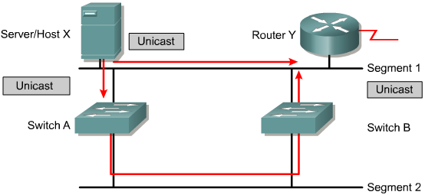
Multiple frame transmissions
Notes:
See 7.1.5
Assume that the MAC address of Router Y has been timed out by both switches. Also assume that Host X still has the MAC address of Router Y in its ARP cache and sends a unicast frame to Router Y. The router receives the frame because it is on the same segment as Host X.
Switch A does not have the MAC address of the Router Y and will therefore flood the frame out its ports. Switch B also does not know which port Router Y is on. Switch B then floods the frame it received causing Router Y to receive multiple copies of the same frame. This is a cause of unnecessary processing in all devices.

Slide 8
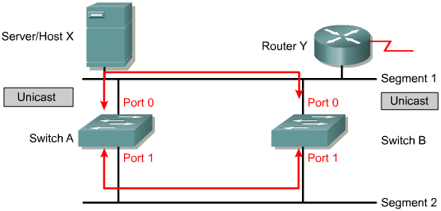
Media access control database instability
Notes:
See 7.1.6
In this example the MAC address of Router Y is not in the MAC address table of either switch.
Host X sends a frame directed to Router Y. Switches A and B learn the MAC address of Host X on port 0.
The frame to Router Y is flooded on port 1 of both switches. Switches A and B see this information on port 1 and incorrectly learn the MAC address of Host X on port 1. When Router Y sends a frame to Host X, Switch A and Switch B will also receive the frame and will send it out port 1. This is unnecessary, but the switches have incorrectly learned that Host X is on port 1.

Slide 9

SPANNING – TREE PROTOCOL

Slide 10
Redundant topology and spanning tree
Redundant networking topologies are designed to ensure that networks continue to function in the presence of single points of failure.
Switches flood traffic out all ports when the traffic is broadcast or multicast or sent to a destination that is not yet known.
In the Layer 2 header there is no Time To Live (TTL). If a frame is sent into a Layer 2 looped topology of switches, it can loop forever.
The solution is to allow physical loops, but create a loop free logical topology

Slide 11
Spanning Tree Protocol
The ST Algorithm, implemented by the STP, prevents loops by calculating a stable spanning-tree network topology.
Spanning-tree frames, called bridge protocol data units (BPDUs), are sent and received by all switches in the network at regular intervals and are used to determine the spanning-tree topology.

Slide 12
STP port status
Blocking:
  No frames forwarded, BPDUs heard
Listening:
  No frames forwarded, listening for frames.
Learning:
  No frames forwarded, learning addresses.
Forwarding:
  Frames forwarded, learning addresses.
Disabled:
  No frames forwarded, no BPDUs heard.

Slide 13
Algorithm
All bridge interfaces eventually stabilize at either a forwarding or a blocking.
One of the bridges is elected as root.
  All root bridge interfaces are in forwarding.
Each bridge receives BPDU from the root, either directly or forwarded by some other bridge.
  The port in which the least-cost BPDU is received is called the root port of a bridge is placed in forwarding.
Notes:
See 7.2.2, 7.2.3, 7.2.4
As a result, for every switched network the following elements exist:
One root bridge per network
One root port per non root bridge
One designated port per segment
Unused, non-designated ports

Slide 14



Root Bridge
Bridge 1
MAC: 1111.1111.1111
Priority: 32768
Root Bridge
Root Port
Root Port
Bridge 2
MAC: AAAA.AAAA.AAAA
Priority: 32768
Bridge 3
MAC: 8888.8888.8888
Priority: 32768

Slide 15
Algorithm (cont.)
For each LAN segment:
  Designated bridge is one bridge sends the forwarded BPDU with the lowest cost.
  The designated bridge’s interface is placed in forwarding state.
  All interfaces of other bridges are placed in blocking state.

Slide 16
Port Cost
1 – 65535
Default port cost for Ethernet:
  10Mbps: 100
  100Mbps: 19
  1Gbps: 4
  10Gbps: 2

Slide 17
Designated Bridge
Bridge 1
MAC: 1111.1111.1111
Priority: 32768
Root Bridge
Port: 100Mbps
Port: 10Mbps
Cost 19
Cost 100
Bridge 2
MAC: AAAA.AAAA.AAAA
Priority: 32768
Bridge 3
MAC: 8888.8888.8888
Priority: 32768

Slide 18
Algorithm (cont.)
Hello Time (2s):
  The root sends BPDU every Hello time
  All bridges use the same value
MaxAge time (20s):
  If a bridge does not receive a BPDU for MaxAge time It begins the process of causing the Spanning Tree to change.
Forward Delay time (15s):
  Listening time between blocking and forwarding. After that, the state is changed to learning.

Slide 19

Rapid Spanning-Tree Protocol (802.1w)
Share link
Edge link
Pt-pt link
Notes:
See 7.2.7
The “blocked” state of a port has been renamed as the “discarding” state. A role of a discarding port is an “alternate port”. The discarding port can become the “designated port” in the event of the failure of the designated port for the segment.
Link types have been defined as point-to-point, edge-type, and shared. Point-to-point links and edge-type links can go to the forwarding state immediately.
Network convergence does not need to be any longer than 15 seconds with these changes

Slide 20

Summary
The benefits and risks of a redundant topology
The role of spanning tree in a redundant-path switched network

Slide 21

Q&A
Notes:
_________________________________________________________________________
_________________________________________________________________________
_________________________________________________________________________
_________________________________________________________________________
_________________________________________________________________________
_________________________________________________________________________
_________________________________________________________________________
_________________________________________________________________________
_________________________________________________________________________
_________________________________________________________________________
_________________________________________________________________________
_________________________________________________________________________
_________________________________________________________________________
_________________________________________________________________________
_________________________________________________________________________
_________________________________________________________________________
_________________________________________________________________________
_________________________________________________________________________
_________________________________________________________________________

Slide 22
Enjoy the Course
Notes:
_________________________________________________________________________
_________________________________________________________________________
_________________________________________________________________________
_________________________________________________________________________
_________________________________________________________________________
_________________________________________________________________________
_________________________________________________________________________
_________________________________________________________________________
_________________________________________________________________________
_________________________________________________________________________
_________________________________________________________________________
_________________________________________________________________________
_________________________________________________________________________
_________________________________________________________________________
_________________________________________________________________________
_________________________________________________________________________
_________________________________________________________________________
_________________________________________________________________________
_________________________________________________________________________

